Slide 1



Machine Learning
and Deep Learning
: A Beginner's Guide
Discover the world of artificial intelligence through machine learning and
deep learning. This guide introduces key concepts, algorithms, and
techniques for beginners entering this exciting learning field.

Slide 2
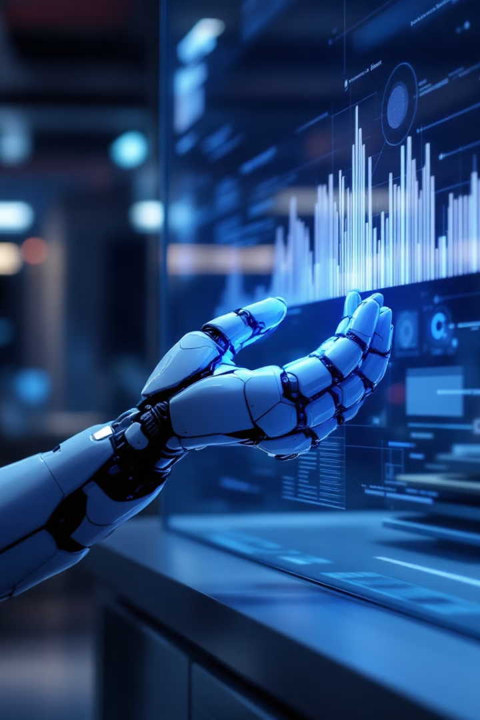
What is Machine Learning?
1
Definition
2
Applications
Machine learning is a subset of AI that enables systems to learn from data without the
explicit programming.
It's used in various fields,
including image recognition, natural language processing, and predictive analytics.
3
Algorithms
Machine learning utilizes algorithms like decision trees, support vector machines, and neural networks.

Slide 3

What is Machine Learning?
Learning from Data
Continual Improvement
Machine learning empowers
computers to learn from data
without explicit programming.
Instead of relying on predefined
rules, algorithms identify pattern and make predictions based on
the information they are fed.
Machine learning algorithms are designed to improve their
performance over time. As they encounter more data, they refine their models and enhance their ability ,
to make accurate predictions.
Wide Applications
Machine learning has applications across various domains, including
image recognition, natural language processing, fraud detection, medical diagnosis, and personalized recommendations.

Slide 4

Deep Learning :
The Next Frontier
1
Definition
Deep learning is a subset of machine learning using
multi-layered neural networks.
2
Advancements
It has revolutionized AI with breakthroughs in image and
speech recognition.
3
Applications
Deep learning powers autonomous vehicles, virtual assistants, and advanced medical diagnostics.

Slide 5
Fundamental Concepts in Machine Learning
Binary Classification
Features
K-Nearest Neighbors
Task of categorizing data into
two classes. Uses algorithms like
logistic regression and SVMs.
Input variables used for prediction.
Feature selection and engineering are
crucial for model performance.
Simple yet effective algorithm for
classification and regression based on proximity to neighbors.

Slide 6
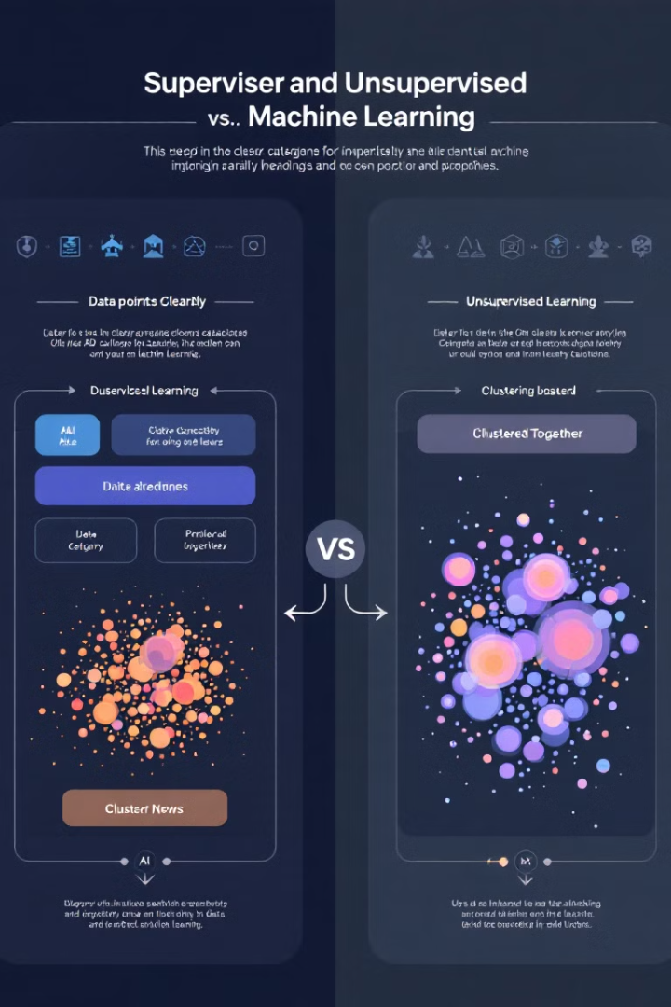

Types of Machine Learning
Supervised Learning
Unsupervised Learning
Models learn from labeled data. Used for classification and regression tasks.
Discovers patterns in unlabeled data. Includes clustering and
dimensionality reduction
techniques.
Sampling Bias
Data Preprocessing
Occurs when training data
doesn't represent the population. Can lead to inaccurate models.
Crucial step involving cleaning, normalization, and feature
engineering to improve model
performance.

Slide 7




Regression Techniques
Linear Regression
Models linear relationship between variables.
Simple but effective for many problems.
Polynomial Regression
Extends linear regression to capture non-linear relationships using polynomial functions.
Ridge and Lasso Regression
Regularization techniques to prevent
overfitting in high-dimensional data.

Slide 8

Key terms associated with regression include:
1
Coefficient of Determination
2
Overfitting vs. Underfitting
Measures the proportion of variance in the target variable that is explained by the model.
Overfitting occurs when the model learns the training data too well, leading to poor
performance on unseen data. Underfitting occurs when the model is too simple and
doesn't capture the underlying patterns in the data.
3
Weight (Coefficient)
4
Hyperparameter
Represents the strength and direction of the relationship between a feature and the target
variable.
A parameter that is not learned by the model but is set before training, such as the
regularization strength in Ridge or Lasso regression.

Slide 9




Optimization Techniques
Stochastic Gradient Descent
Updates model parameters using one training example at a time. Fast but noisy.
Mini-batch Gradient Descent
Balances speed and stability by using small batches of training data.
Batch Gradient Descent
Uses entire dataset for each update.
Stable but computationally expensive for large datasets.

